Slide 1
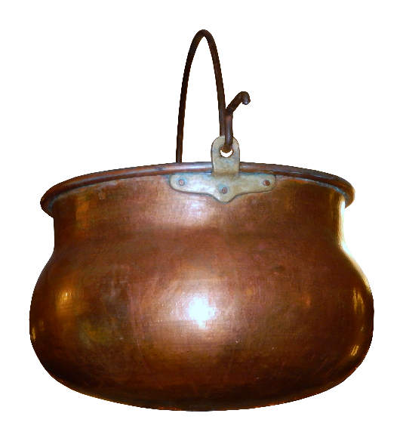
Properties of copper
Copper is malleable. It can be hammered into shape.
Select the statement that best explains this property.
Copper atoms are soft and can be easily squashed.
There are no forces of attraction between copper atoms.
The copper atoms can be made to slide across each other.
Copper atoms can be flattened if hit hard enough.

